Slide 1

DSC170 Spatial Data Science and Application
Optimizing Hospital Location
in San Diego
Sungjin Choi
Joon Ha Cha

Slide 2
Contents
1. Purpose/Goal
3. EDA
5. Conclusion
2. Data
4. Analysis

Slide 3
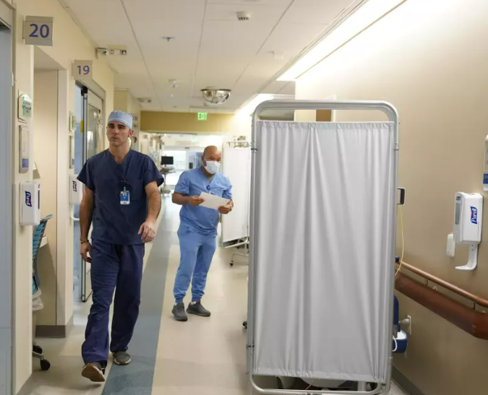
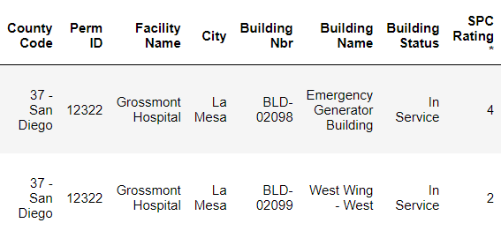
0. What is the issue?
“Sharp HealthCare, the region’s largest medical provider, said that its four hospitals in San Diego, Chula Vista, La Mesa and Coronado have, on average, 35 emergency patients waiting for placement per day, and handled nearly 2,500 involuntary holds over the past 12 months.”
The San Diego Union Tribune
Current Hospital Data
+
Notes:
Worsened after COVID-19 pandemic

Slide 4
1. Purpose & Goal
We aim to identify the most suitable locations for a new hospital in San Diego by analyzing spatial data on school lands, income levels by county, and road traffic injuries
The project’s goal is to understand how spatial distribution of these factors influences the need for healthcare services, aiming to propose locations that would optimize accessibility, community need, and safety.
+

Slide 5
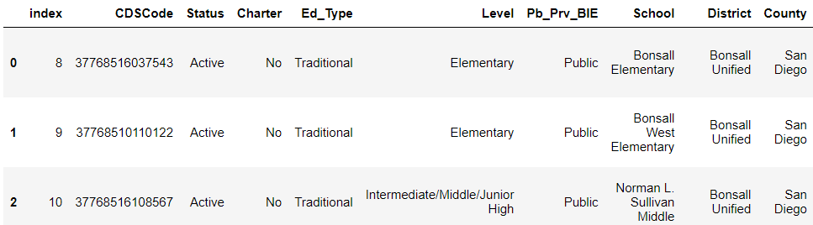
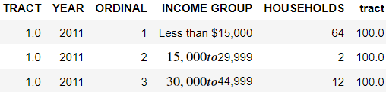
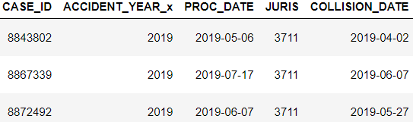
2. Data
San Diego School
+
Income + Tract
Crash + Victim
+
+

Slide 6
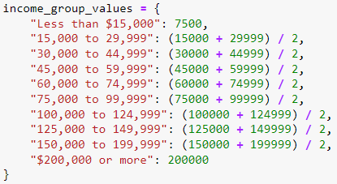
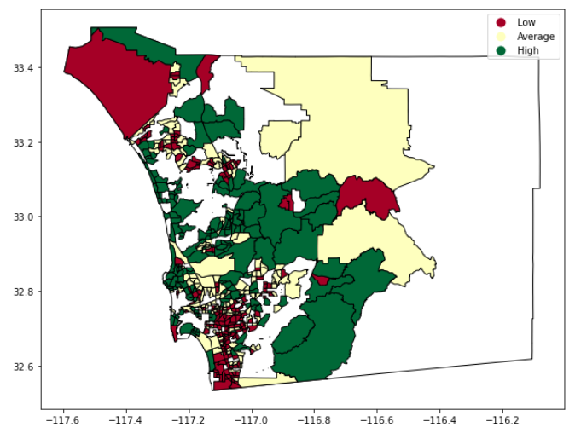

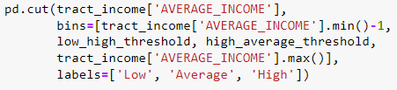
3. EDA
1) Income
Income
10 income groups
+ Households
+ Census Tract
Income Bracket Averaging
+
+
Merge
Census Tract
Census Tract
+ Geometry (Polygon)
Quantile Thresholds
+
Income Distribution Map
Showing different income levels across the SD
Colors representing with low, average, and high income
Income Categorization
+
+

Slide 7
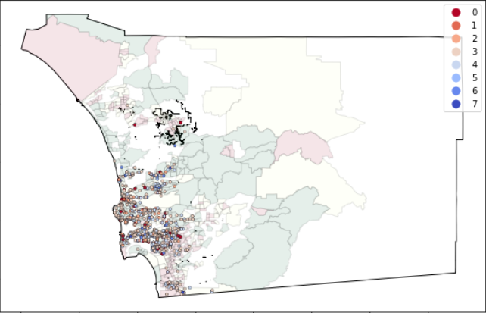
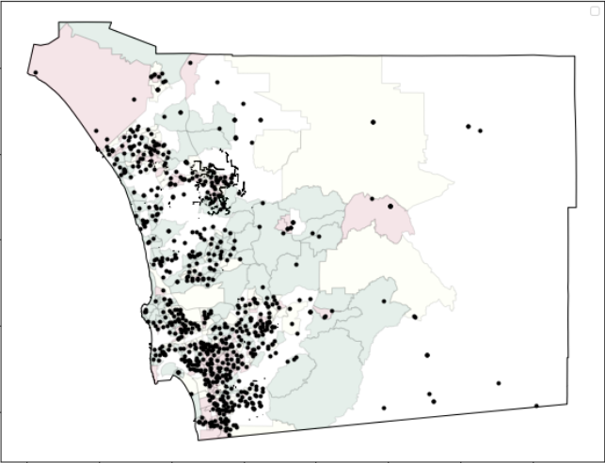
3. EDA
2) Income + Crash / School Location
Income + Crash Data
Income + School Data
+
+

Slide 8
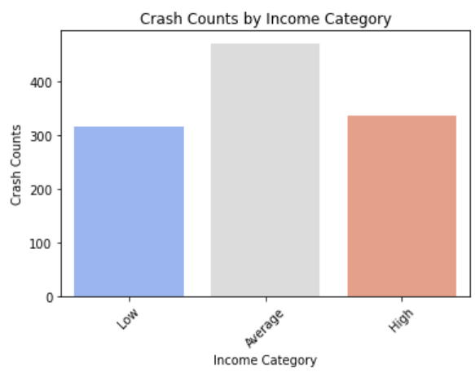
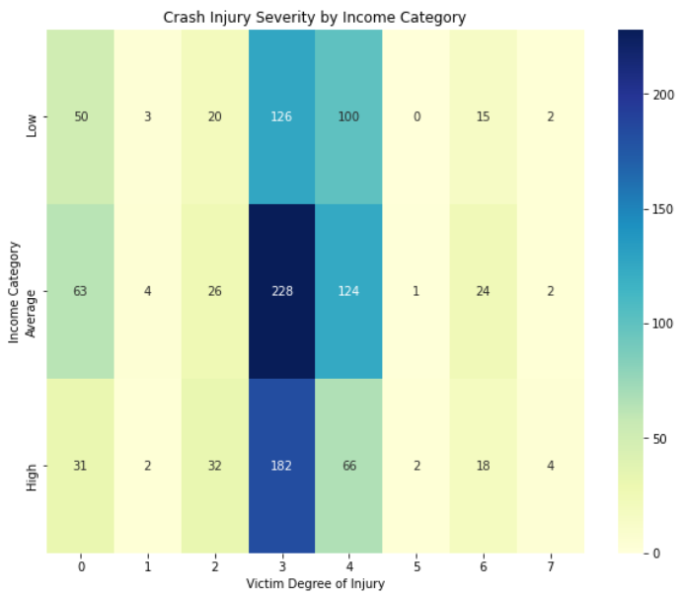
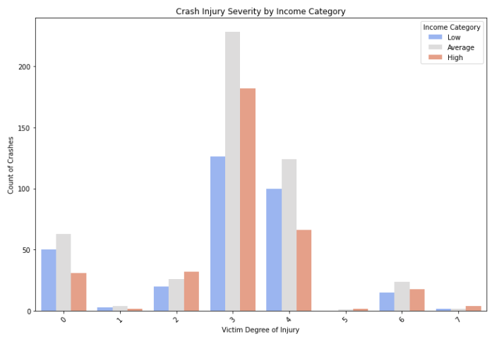
4. Analysis
1) Relationship between Crash Location and Income
+
Income vs # of Crash
Heatmap
Income vs # of Crash
+
+
+

Slide 9
4. Analysis
1) Relationship between Crash Location and Income
+
Chi-Squared Test
P-Value
+
+
Higher Values
→ Less Chance randomness
Income vs # of Crash
Chi-square Statistics = ~0
→ no relationship
Lower Values
→ Less Chance Randomness
Income vs # of Crash
P-Value = ~1
→ Lack of evidence

Slide 10
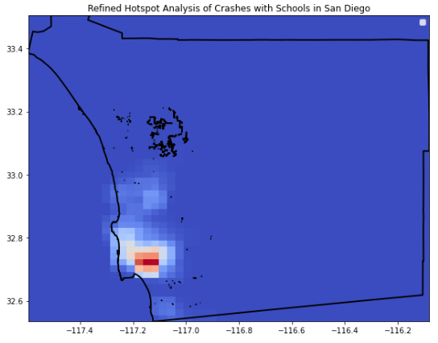
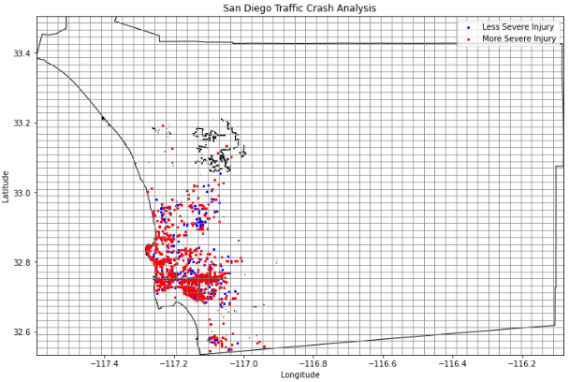
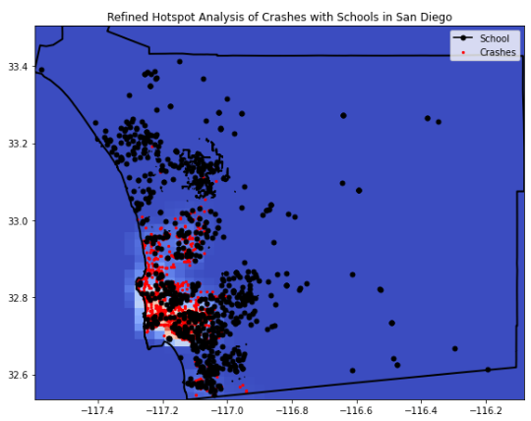
4. Analysis
2) Hot Spots and Cold Spots
+
Created an Artificial Grid
Median
Hotspot Analysis
Measure Spatial Autocorrelation
Visualization
Indicating Significant Areas
+
+
+

Slide 11
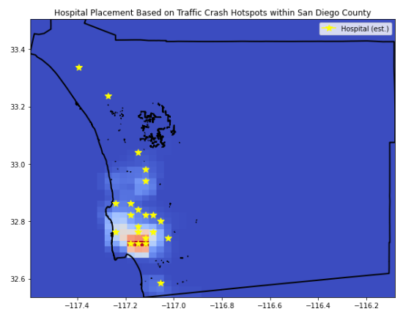
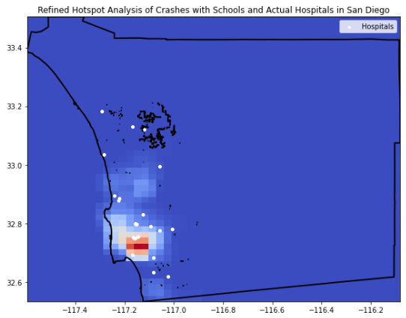
5. Results
Location of Hospitals
Optimized Location
Actual Location
+
+

Slide 12
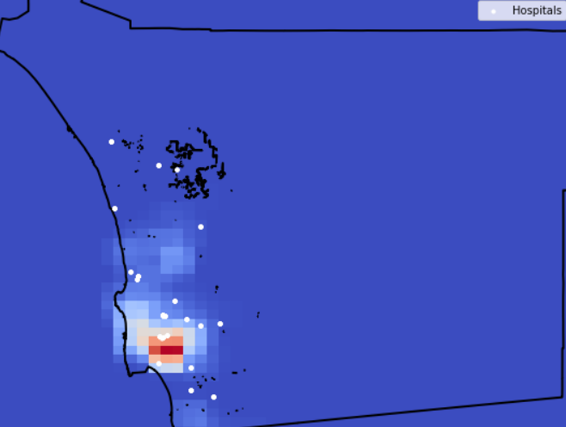
6. Conclusion
Better Health Care
130.2%
202X
Support Healthcare in specific area
Hopeful Increase in health care
Found Relationship in Data

Slide 13
Thank you

